Slide 1
Technology and Community Resilience in a Disaster
Patrick Trinkle
CMSC691 – Med. Software Eng.
Spring 2010
tri1@umbc.edu

Slide 2
Introduction
Disasters include tsunamis, earthquakes, hurricanes, tornados, and wars.
Different locations bring their own challenges.
Language barriers, terrain, potable water, communications
Notes:
I’m going to attempt to interleave the technologies with their applications to a disaster scenario.

Slide 3
Intro (cont)
Technology helps:
Wireless Communications
Web 2.0
Open Reference
Videos
Handheld Devices
Telemedicine

Slide 4
Aid Workers
Types:
Police
Search & Rescue
Medical Staff
Logistics People
Fire brigade
Issues:
Communications/Logistics
Language Barriers
Supplies

Slide 5
Communications
If there is an existing infrastructure and it is operating it may be clogged.
It may have been destroyed.
It may have never existed.
Solution: Wireless communications deployed on site.

Slide 6
Wireless
Requirements:
Easy,
Reliable,
Ad-hoc
MANETs (mobile ad hoc network)
Mesh Network, no hierarchy
Notes:
MANET: Each node is both a node and a router.

Slide 7
Approach to Command & Control
Headquarters
Medical Team 1
Medical Team 2
S & R 1
S & R 2
S & R 3

Slide 8
Another Approach
Headquarters
Medical Lead
S & R Lead
Medical Team 1
Medical Team 2
S & R 1
S & R 2
S & R 3

Slide 9
Telemedicine
Long distance doctors – video teleconference
Robotic Surgery (too expensive to move equipment)
Using handheld electronic devices to forward information from rescue workers to the medial team

Slide 10
Web 2.0
User Created Content
Open Reference
OpenStreetMap.org, Wikipedia.org
Mashups
Videos
Youtube.com, Facebook
Photos
Flickr, Facebook, Picasa, etc.

Slide 11
Open Reference
Wikipedia.org
Free encyclopedia for the people
OpenStreetMap.org
Free maps for the people, by the people
Sans Warranty, but can be rather reliable
Before the earthquake in Haiti there was very minimal data on the OpenStreetMap.org. This changed quickly to help the search/rescue and medical workers.

Slide 12
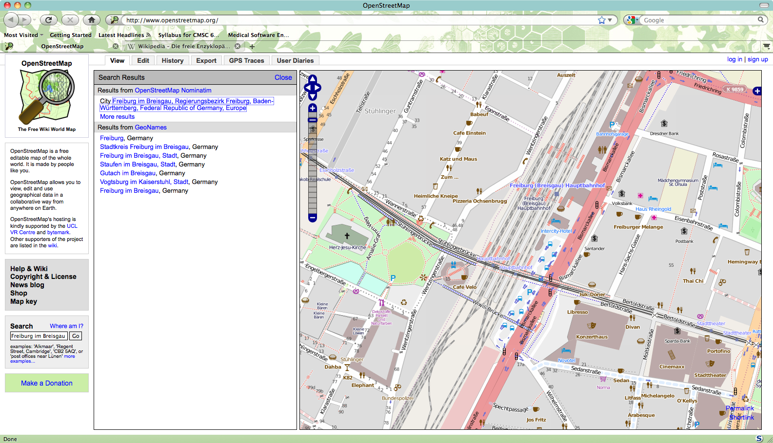
Freiburg im Breisgau on OpenStreetMap.org

Slide 13
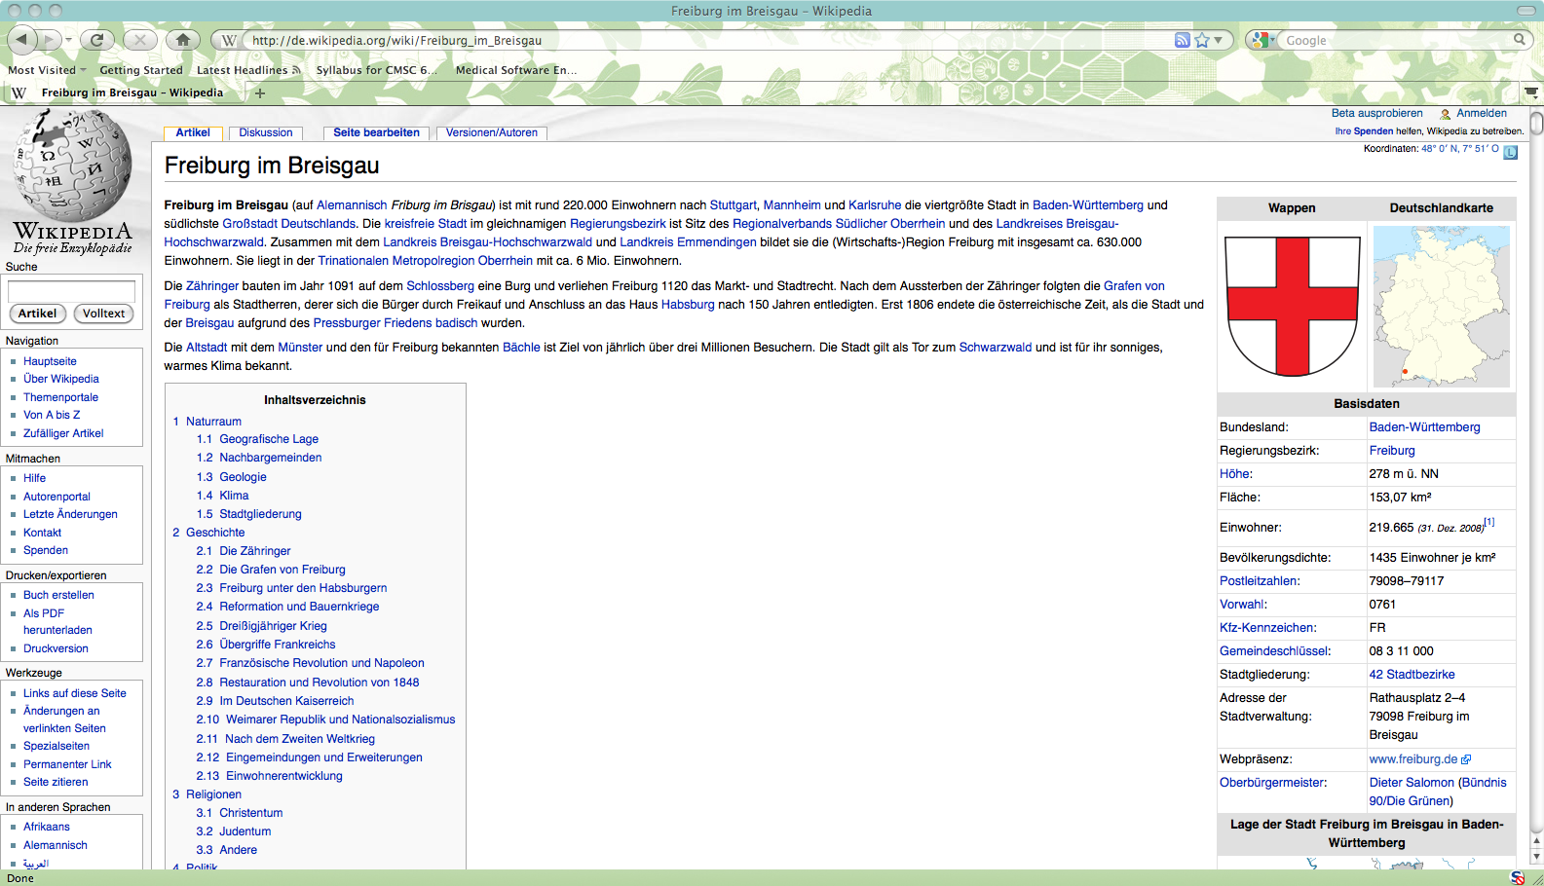
Freiburg im Breisgau, on Wikipedia.org

Slide 14
Mashups
Given data from X, correlated with data from Y.
New information!
Implications for public health
In a disaster these can be used to aid workers, possibly overlaying the locations and quantities of survivors found over a map of the area.

Slide 15
Video/Pictures
Youtube.com
Channels for focused content
Free (paid for by advertising)
Post videos for mass consumption
Flickr, Picasa, Social Networking Software
Share photos with others

Slide 16
Videos from Disaster
Short videos from disaster survivors explaining their condition with the goal of off-site family members seeing them.

Slide 17
Handheld Devices
GPS – Global Positioning System for reporting locations of people
Wista research
PDA with special software for collecting and reporting medical information
This device can transmit the data as text and pictures and video back to the medical staff
Device is carried by the search & rescue workers

Slide 18
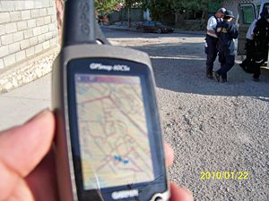
It comes together…
OpenStreetMap on a Garmin Handheld device in Haiti with Search & Rescue Crews

Slide 19
Amusingly enough, Current UMBC Research
Master's Thesis Defense Announcement - Niyati Chhaya
Title: Feature Extraction from Images of Mass Disaster Victims
Candidate: Niyati Chhaya Date: Wednesday, April 28th, 2010 Time: 10:00 AM Place: ITE 346

Slide 20
Future Research
Feasibility and costs of recording and releasing short videos from the survivors
Does it really help? (survey survivors and families)
Does it cause more concern?
Identifying people/feature extraction from blurry pictures taken on-scene.
Currently a research problem being worked

Slide 21
Conclusion
Applying technical solutions to disasters can aid in a myriad of ways
Wireless communications
Telemedicine
Handheld devices
Web 2.0
Reference and video
For a full set of references, see “Examination of Disaster Telemedicine and Community Resilience”

